Slide 1
Decision Tree

Slide 2
Decision Tree
Decision tree - algorithms for classification.
As the name indicates, it builds a model in the form of a tree structure.

Slide 3
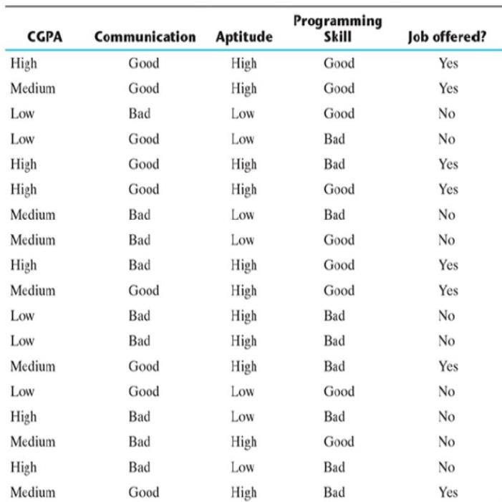
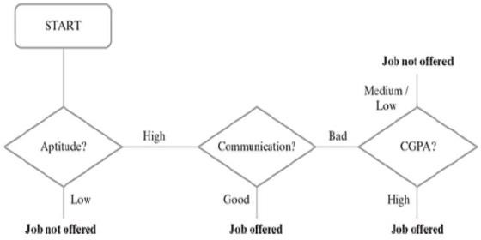

Slide 4
How Decision Tree is formed?
The process of forming a decision tree involves recursively partitioning the data based on the values of different attributes.
The algorithm selects the best attribute to split the data at each internal node, based on certain criteria such as information gain or Gini impurity.
The biggest challenge of a decision tree algorithm is to find out which feature to split upon.
The main driver for identifying the feature is that the data should be split in such a way that the partitions created by the split should contain examples belonging to a single class. If that happens, the partitions are considered to be pure.

Slide 5

Entropy
Entropy is a measure of impurity of an attribute
Entropy is the measure of uncertainty of a random variable
Let us say S is the sample set of training examples. Then, Entropy (S) measuring the impurity of S is defined as
where c is the number of different class labels and p refers to the proportion of values falling into the i-th class label.

Slide 6

Information Gain
Information gain for a particular feature A is calculated by the difference in entropy before a split (or S_{bs}) with the entropy after the split (S_{as}).
Constructing a decision tree is all about finding an attribute that returns the highest information gain (i.e. the most homogeneous branches).

Slide 7
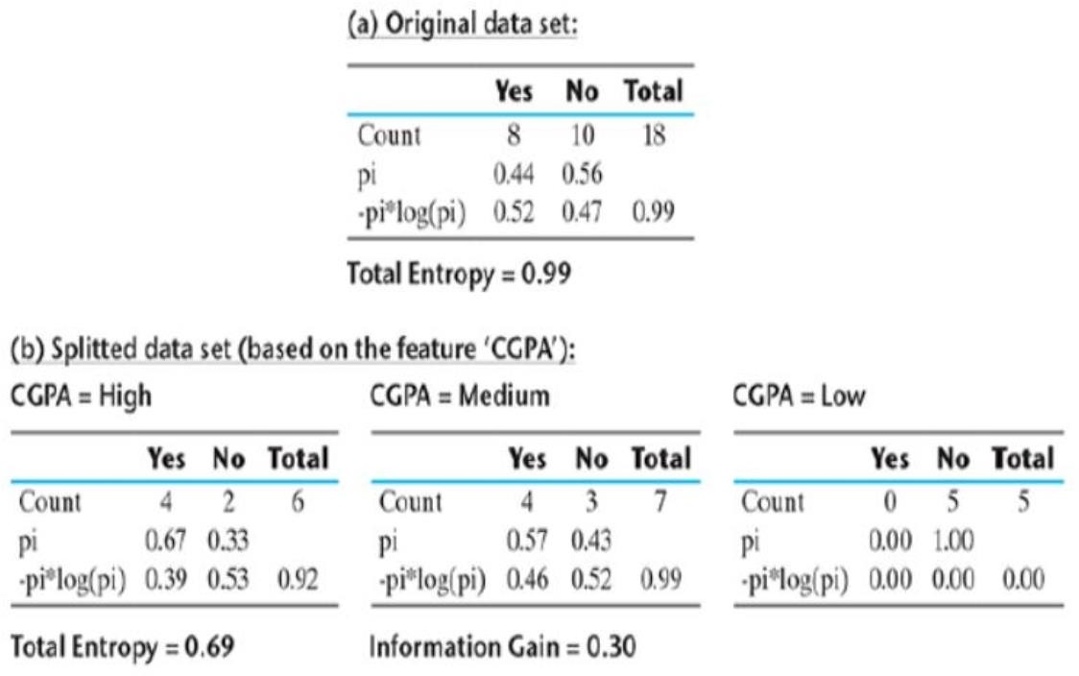

Slide 8
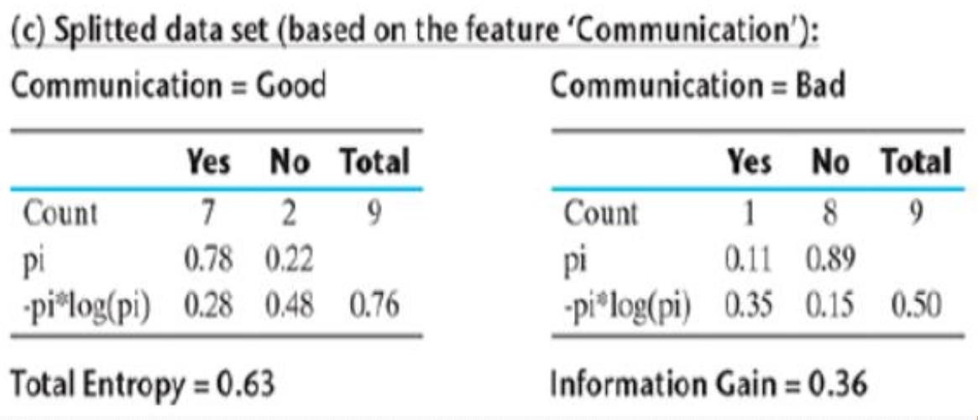

Slide 9
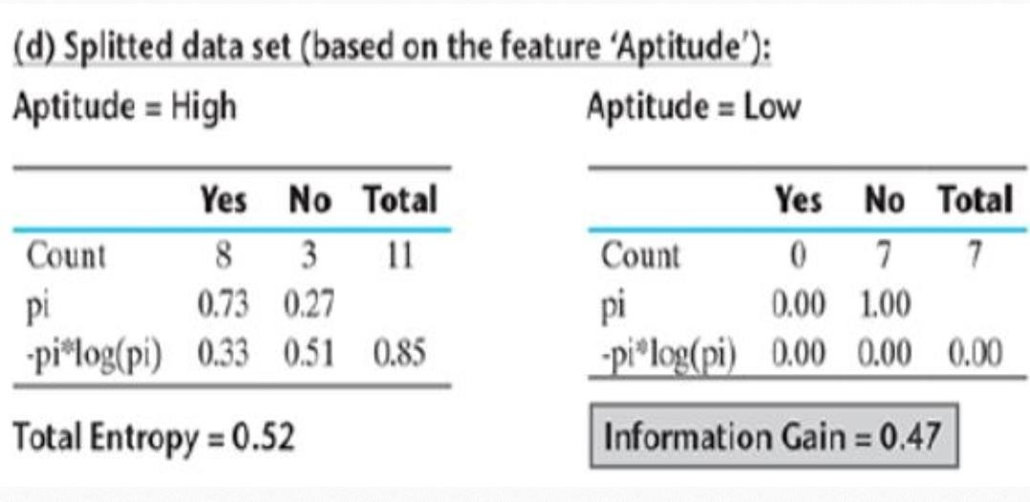

Slide 10
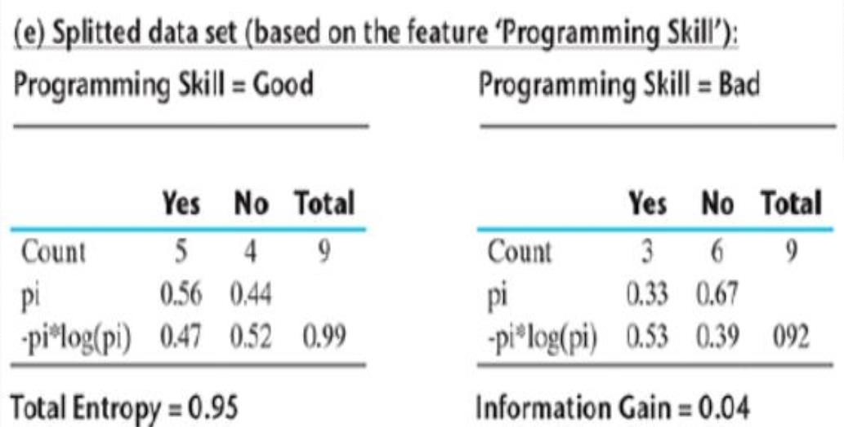

Slide 11
Aptitude
Hence, it is quite evident that among all the features, Aptitude results in the best information gain when adopted for the split.
So, at the first level, a split will be applied according to the value of Aptitude or in other words, Aptitude will be the first node of the decision tree formed.
One important point to be noted here is that for Aptitude = Low, entropy is 0,which indicates that always the result will be the same irrespective of the values of the other features.
Hence, the branch towards Aptitude = Low will not continue any further.

Slide 12
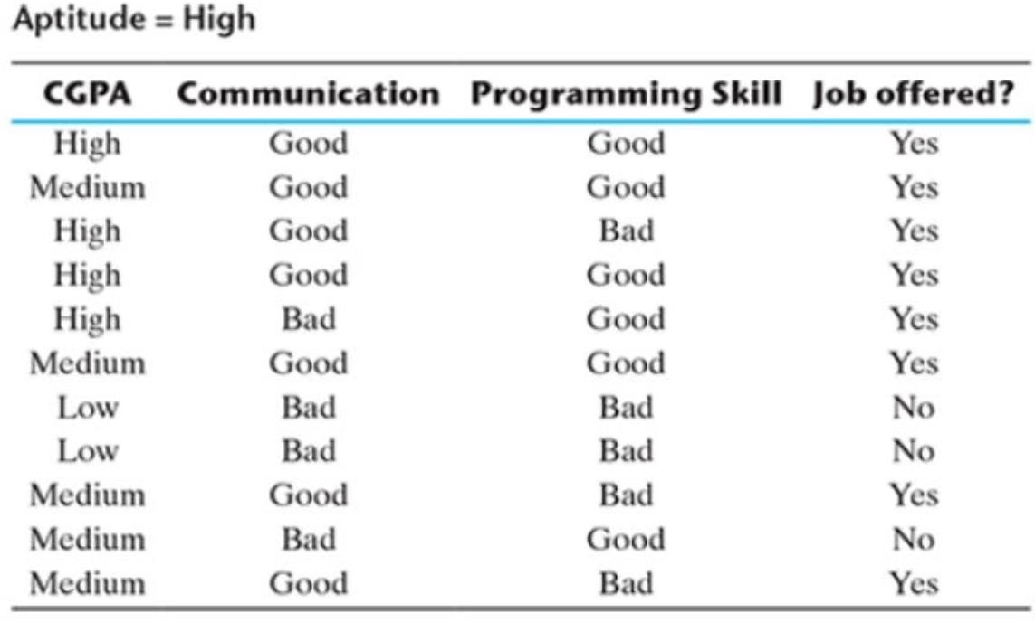

Slide 13
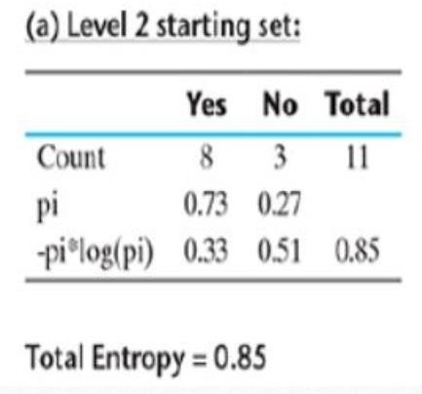

Slide 14
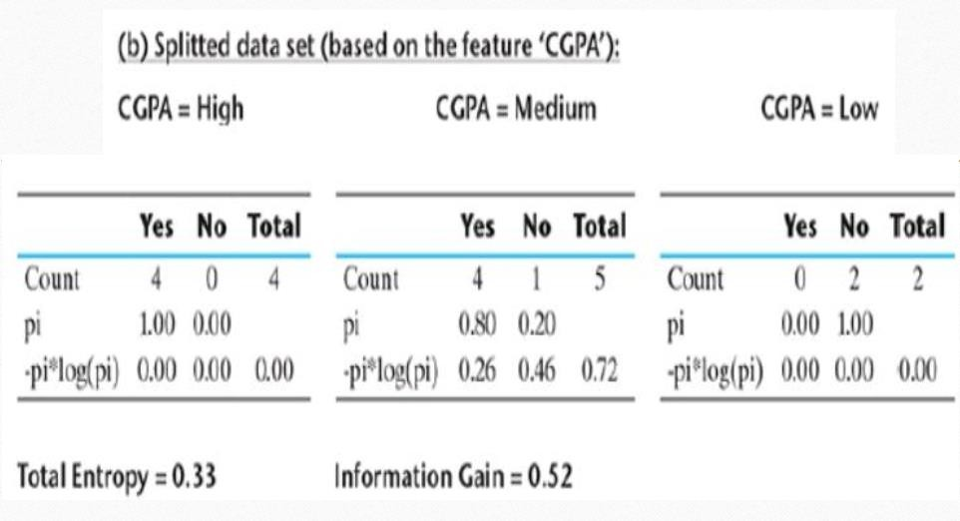

Slide 15
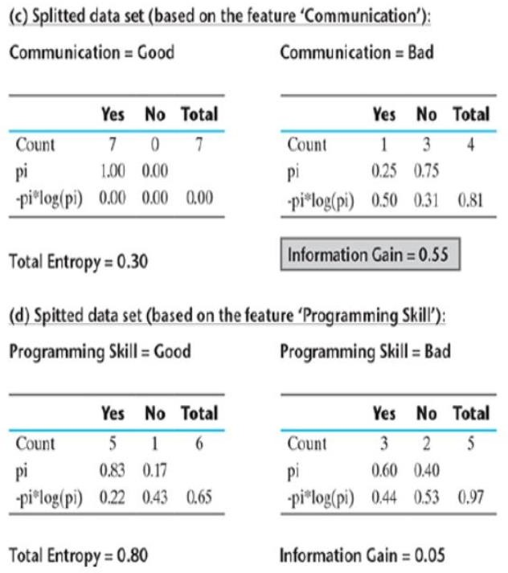

Slide 16
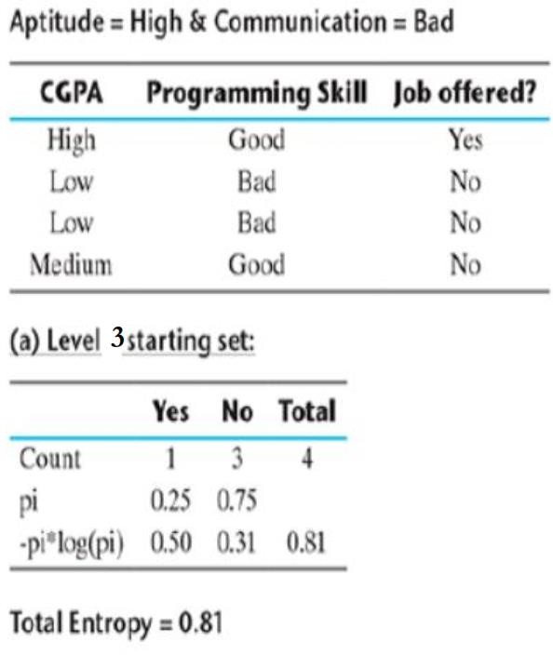

Slide 17
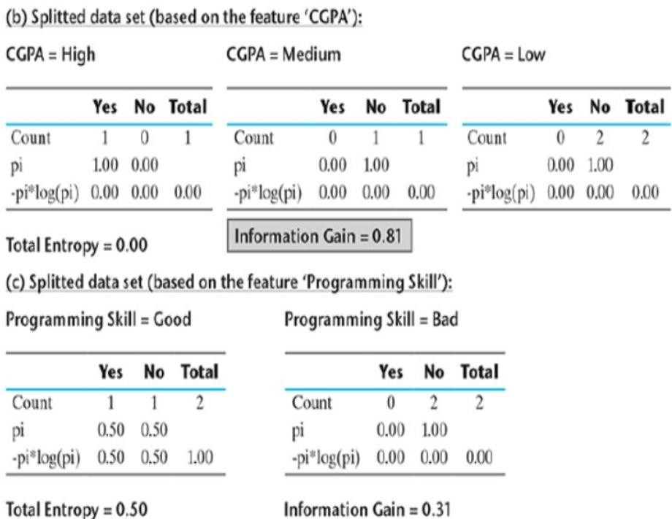

Slide 18
